Slide 1
Sexuality Squabble
These Are Our Bodies
Intermediate

Slide 2
Practice Round: Parables
X
X
X
X
X
X
Answer 1
Answer 6
Vineyard Owner
Lazarus
Answer 2
Christ Church
Good Samaritan
Answer 3
Christ Church
Mustard Seed
Answer 4
Christ Church
Rich Young Ruler
Answer 5
Christ Church
Prodigal Son
Reset Board
X
X
X

Slide 3
Using Technology Responsibly
X
X
X
X
X
Answer 1
Answer 6
Use the Grandmother Test
Share devices with family
Answer 2
Christ Church
Nothing is private
Hurtful words are hurtful whether you type them or say them
Answer 3
Christ Church
Don’t give into peer pressure
Answer 4
Christ Church
Answer 5
Christ Church
Have no regrets
Reset Board
X
X
X

Slide 4
SEXUAL ABUSE
X
X
X
X
X
X
To abuse something is to use it in an improper or destructive way
If someone makes you feel uncomfortable , tell them to stop
and tell a trust worthy adult
Answer 1
Answer 6
Often people who are abusive are misusing their power to hurt others.
Answer 2
Christ Church
In most cases, sex abusers are acquaintances.
Answer 3
Christ Church
Sex abusers may have been abuse themselves.
Answer 4
Christ Church
Sex abusers are guilty of a sexual crime.
Answer 5
Christ Church
Reset Board
X
X
X

Slide 5
STI -
X
X
X
X
X
X
Sexual Contact
Answer 1
Christ Church
Altar
Exchange of bodily fluids
Answer 2
Christ Church
Altar Clothes
Answer 3
Christ Church
Unusual for STI to spread other than human to human contact
Candles
Answer 4
Urine, blood, saliva or semen
Christ Church
Lecture/ Pulpit
Kneeler
Christ Church
Priests
Reset Board
X
X
X

Slide 6
STI – Common Types
X
X
X
X
X
X
Syphilis
Answer 1
Christ Church
Altar
Gonorrhea
Answer 2
Christ Church
Altar Clothes
Answer 3
Christ Church
Chlamydia
Candles
Genital herpes
Answer 4
Christ Church
Lecture/ Pulpit
Kneeler
Christ Church
Priests
Reset Board
X
X
X

Slide 7
Dating and Falling in Love
X
X
X
X
X
X
Answer 1
You will be developing friendships
Learn to understand yourself
Answer 6
Talk together about your feelings
May want to build deeper relationships
Answer 2
Answer 7
Answer 3
Christ Church
Be true to yourself
Letter to the Corinthians
Answer 4
Show respect for each other
Christ Church
Created by God to love
Answers 5
Christ Church
Reset Board
X
X
X

Slide 8
HIV/AIDS Definitions
X
X
X
X
X
X
AIDS stands for Acquired Immunodeficiency Syndrome
HIV is the virus that can lead to AIDS, commonly called HIV/AIDS
Answer 1
Answer 6
AIDS is a disease caused by a virus called HIV
Answer 2
Christ Church
AIDS can be spread from an infected person to an uninfected person by exchange of blood, breast milk, semen, vaginal fluids, mucus ,urine
Answer 3
Christ Church
HIV is an STI that can lead to AIDS if left untreated.
Answer 4
Christ Church
HIV stands for human immunodefieciency virus
Answer 5
Christ Church
Reset Board
X
X
X

Slide 9
Symptoms of STI
X
X
X
X
X
X
Unusual discharge (leaking of thick fluid) from the penis or vagina
Altar
Answer 1
Christ Church
Irritation, lumps or sores on or around the genitals
Altar Clothes
Answer 2
Christ Church
Answer 3
Pain or tenderness in the genitals, genital area or abdomen
Candles
Christ Church
Painful urination of frequent need to urinate
Answer 4
Lecture/ Pulpit
Christ Church
Kneeler
Priests
Christ Church
Reset Board
X
X
X

Slide 10
Technology & Bullying
X
X
X
X
X
Bullying via internet is still bullying
Answer 1
Answer 6
Share devices with family
Bullying via text or social media is still bullying
Answer 2
Christ Church
Answer 3
Christ Church
What you type is permanent
Bullying won’t help you make or keep good friends
Answer 4
Christ Church
Answer 5
Christ Church
Have no regrets
Reset Board
X
X
X

Slide 11
SEX for Sale
X
X
X
X
X
Image that exploits sexuality and misuses the gift of sexuality
Answer 1
Answer 5
Picture or image that turns a person into a sex object.
Answer 2
Christ Church
Pictures or video that promote sexual relationships between children & adults
Answer 3
Christ Church
Pictures or video that link sex with violence
Answer 4
Christ Church
Answer 5c
Christ Church
Reset Board
X
X
X

Slide 12
How HIV is Contracted
X
X
X
X
X
X
Having sexual contact with an infected person
Christ Church
Answer 1
sharing of needles and syringes by users of drugs
Christ Church
Answer 2
Unsafe ear piercing and tattooing
Christ Church
Answer 3
Answer 4
Christ Church
infected mother to infant during or after birth
Answer 5
Christ Church
Unsafe blood transfusions
Reset Board
X
X
X

Slide 13
Technology & Pornography
X
X
X
X
X
If you see pornography tell your parents
If you someone bullies you online or is mean online, tell an adult or a parent
Answer 1
Answer 6
Talk with your parents about technology
Answer 2
Christ Church
Technology can connect us in relationships
Answer 3
Christ Church
Technology can get in the way of relationships
Answer 4
Christ Church
Whatever you share online is permanent
Answer 5
Christ Church
Reset Board
X
X
X

Slide 14
SEXUALITY
X
X
X
X
X
Is a gift from God
Answer 1
Answer 5
God intends for us to celebrate that gift in ways that make us and others
better human beings
Answer 2
Christ Church
We should seek to accept and
celebrate ALL people
Answer 3
Christ Church
Never hurt others by taking advantage of their feelings
Answer 4
Christ Church
Calling people names or making fun of people is never a Christian way to treat others
Answer 5
Christ Church
Reset Board
X
X
X

Slide 15
WAYS TO STAY SAFE
X
X
X
X
X
X
Talk to your parents. Let them know if anything is troubling you online.
If you see pornography on your computer, tell a parent or adult immediately
Answer 1
Answer 6
Answer 2
Christ Church
Share devices.
Tell a trust worthy adult, if someone hurts you or makes you feel uncomfortable. Tell more than one adult, if you need to.
Answer 3
Christ Church
Answer 4
Christ Church
Avoid all sexual activity
Speak up for yourself and for others.
Answer 5
Christ Church
Reset Board
X
X
X

Slide 16
AM I IN LOVE?
X
X
X
X
X
X
With whom do I enjoy spending time more than anyone else?
Can I trust this person with my personal thoughts and feelings?
Answer 1
Answer 6
Answer 2
Christ Church
Who makes me feel good about myself?
Who do I enjoy discovering new things about?
Answer 3
Christ Church
Answer 4
Christ Church
Who values the things I consider to be important?
Who wants to be close to me but doesn’t insist that we do everything together?
Answer 5
Christ Church
Reset Board
X
X
X

Slide 18
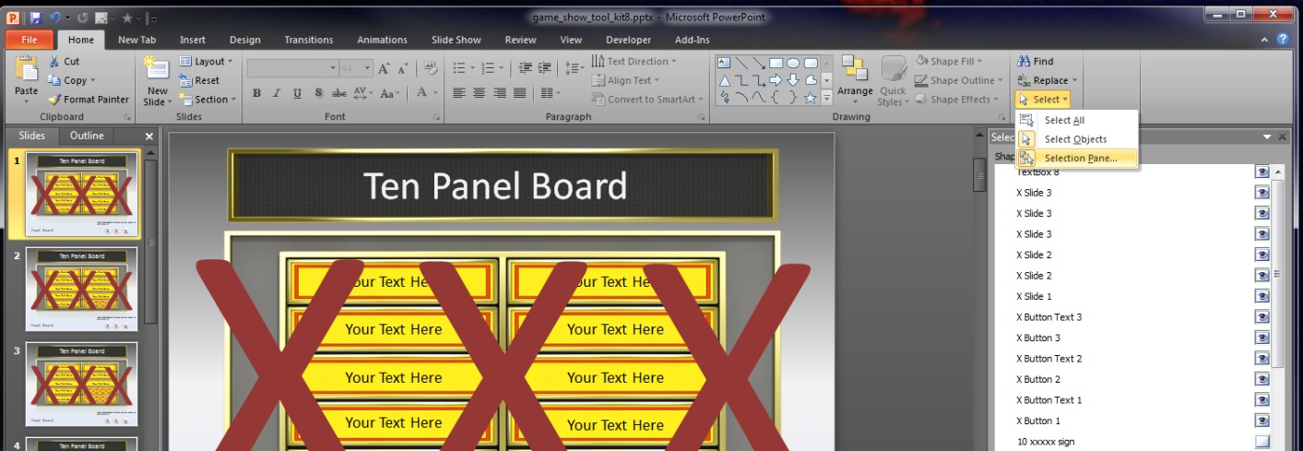
Hiding the 3 X’s tutorial in PP 2007 & 2010
Open the Selection Pane. This is a window where you can see a list of all item on your slide.
The selection pane is now open.
2. Left mouse click the visibility eyes to hide the three X’s while you work.
They are items labeled X Slide
You can turn them back on when you are finished.

Slide 19
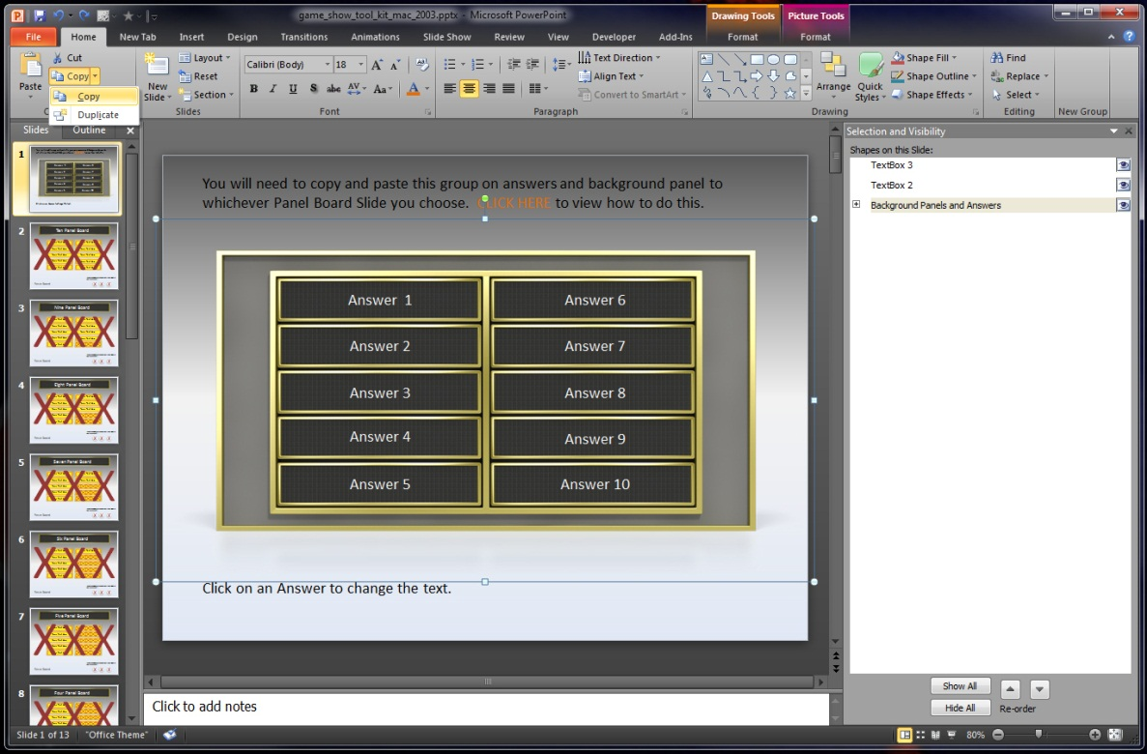
Copying Answers Panel to Panel Board Slide for PowerPoint 2007 & 2010
If you have never used the Selection Pane please view the slide before this.
In the Selection Pane left mouse click on Background Panels and Answers Item to select it.
2. Under the Home tab click copy from the copy drop down menu.
Copying answers to Panel Board Slide continued on next slide

Slide 20
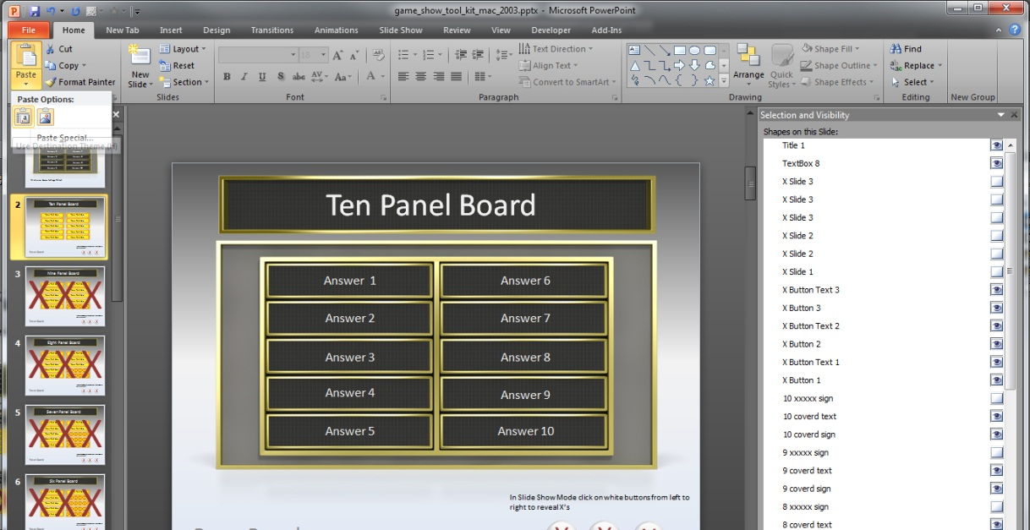
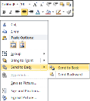
Copying answers to Panel Board Slide for 2007 & 2010
3. Go to Panel Board Slide you would like to Paste Your Answers.
4. Go to Home tab and click Paste and select the first icon from the paste options.
5. Once Pasted into slide right click on the answers board and choose send to back.
To re-edit answer panel simply copy it and paste it on an empty slide. Once your done editing it follow instructions for copying back to Panel Board Slide
You can select the answer board by clicking on the outer edge of the image.
or you can find it in the Selection Pane named Background Panels and Answers

Slide 21
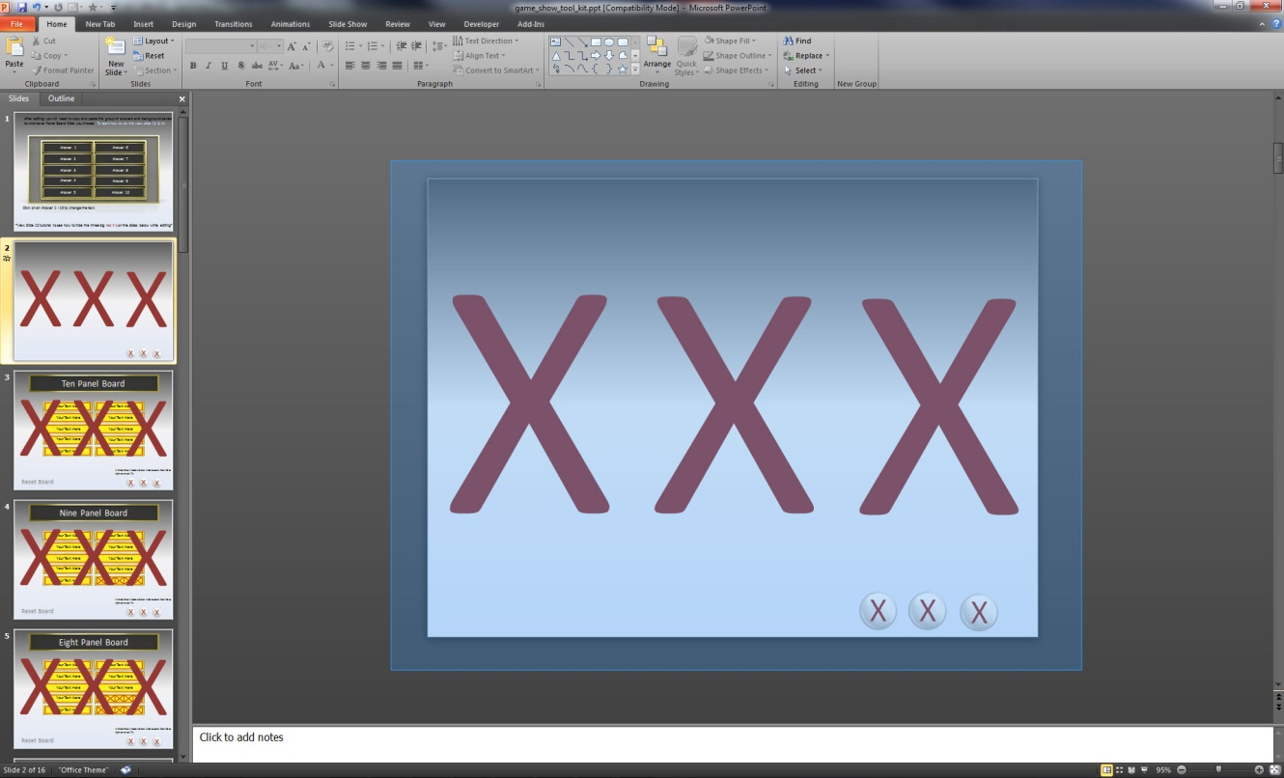
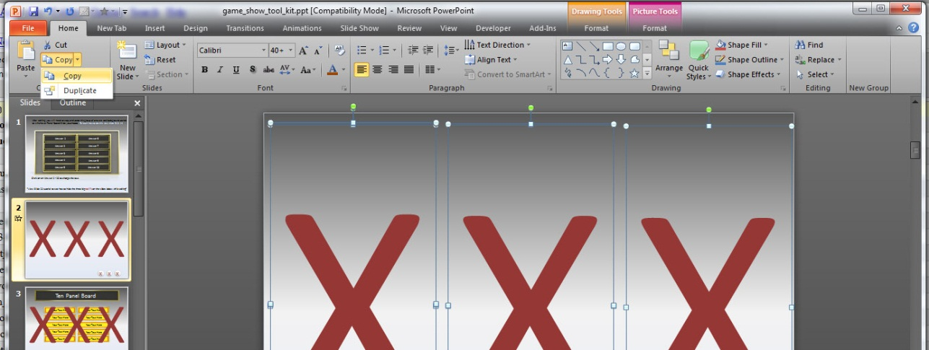
Copying and Pasting Red x’s Tutorial for Mac & 2003 PowerPoint.
3. After deleting the slide text, left mouse drag a selection around the whole slide to select all items.
The drag selection my be represented as a blue box or a dashed line.
4. Once everything is selected go to the Home tab and find copy.
Copying and Pasting x’s for mac & 2003 continued on next slide.

Slide 22
Copying and Pasting Red x’s Tutorial for Mac & 2003 PowerPoint.
3. Now select the slide you want to paste the x’s to.
4. Under the Home tab select paste and click the first icon on the left in the paste options.

Slide 23
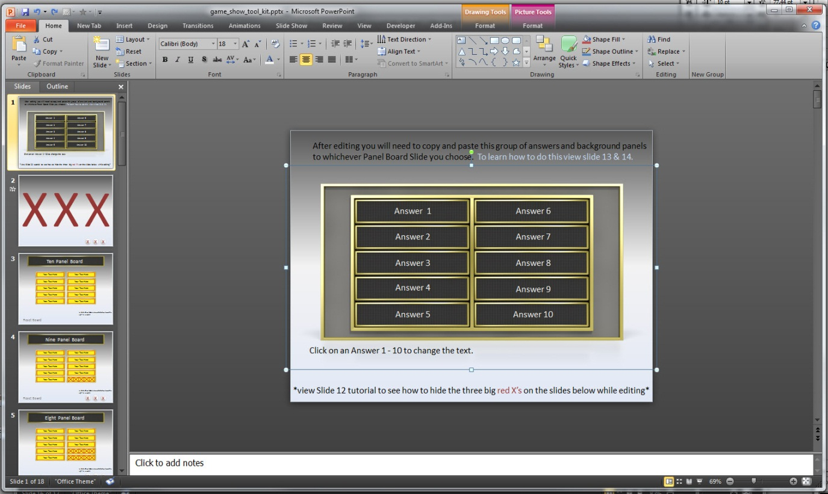
Copying Answers Panel to Panel Board Slide for Mac & 2003 PowerPoint.
The answer board has been grouped together. Left click on the gray area to select the group.
2. Follow the copy and paste instruction from Slide 15 (Copying answers to Panel Board Slide for 2007 & 2010)

